Slide 1


RANSAC
Random Sample Consensus

Slide 2

Example
By using feature detection

Slide 3

In this inliers and outlier are present

Slide 4
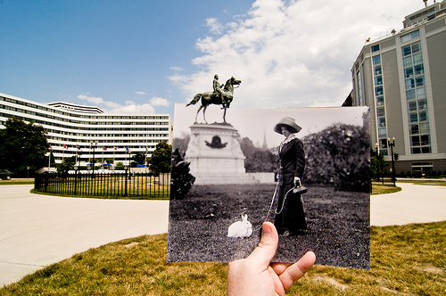

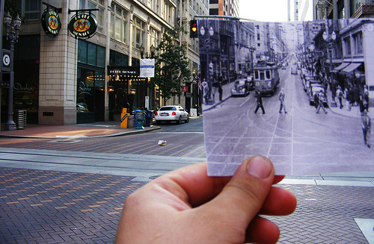
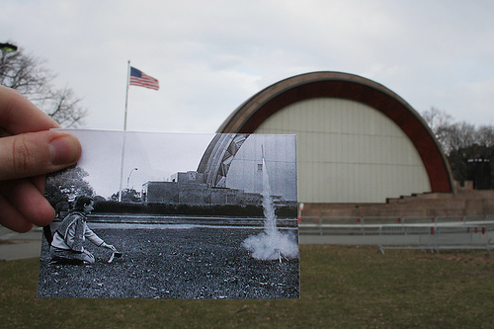
A look into the past
http://blog.flickr.net/en/2010/01/27/a-look-into-the-past/

Slide 5



Image Alignment

Slide 6
Introduction
Trial and error approach
Approach to deal with high fractions of outliers in the data
Key idea: Find the best partition of points in inliers set and outlier and estimate the model from the inlier set
Standard approach for fitting in the presence of outliers

Slide 7
Algorithm
sample the number of data points required to fit the model
Compute model parameter using the sampled data points
Score by the fraction of inliers within a preset threshold of the model
Repeat 1-3 until the best model is found with high confidence

Slide 8
Feature-based alignment outline

Slide 9


Feature-based alignment outline
Extract features

Slide 10
Feature-based alignment outline
Extract features
Compute putative matches

Slide 11
Feature-based alignment outline
Extract features
Compute putative matches
Loop:
Hypothesize transformation T

Slide 12
Feature-based alignment outline
Extract features
Compute putative matches
Loop:
Hypothesize transformation T
Verify transformation (search for other matches consistent with T)

Slide 13
Feature-based alignment outline
Extract features
Compute putative matches
Loop:
Hypothesize transformation T
Verify transformation (search for other matches consistent with T)

Slide 14
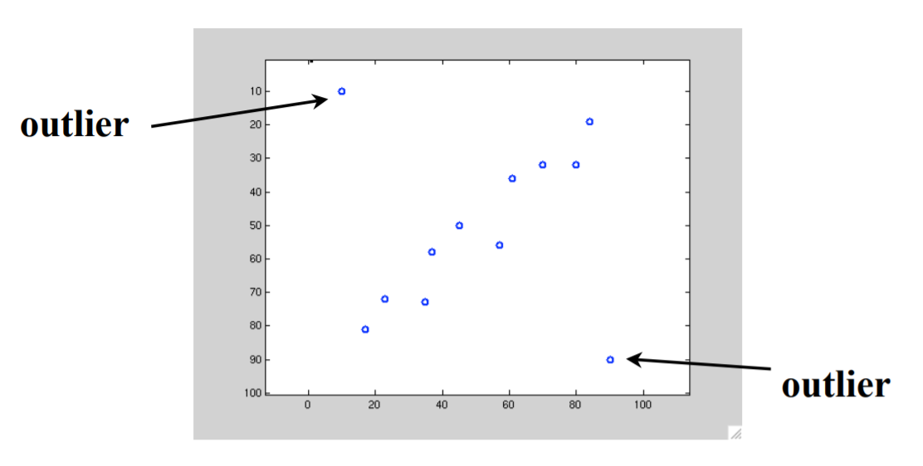
Outliers doesn’t fit the model

Slide 15
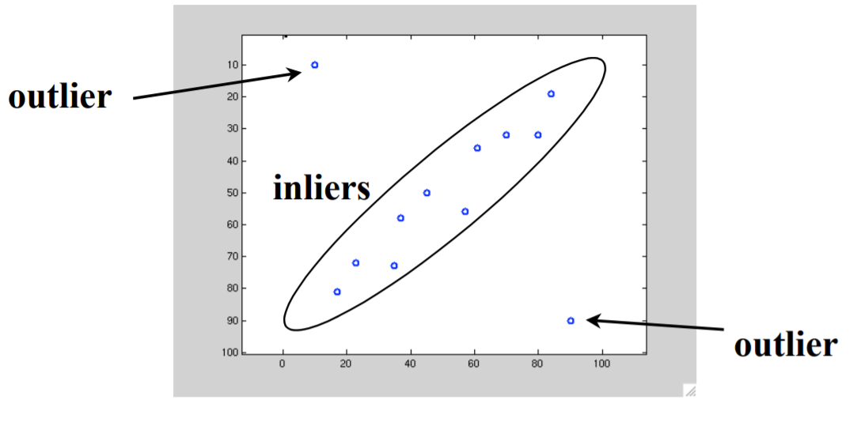
Inliers are best fit to connect the features

Slide 16
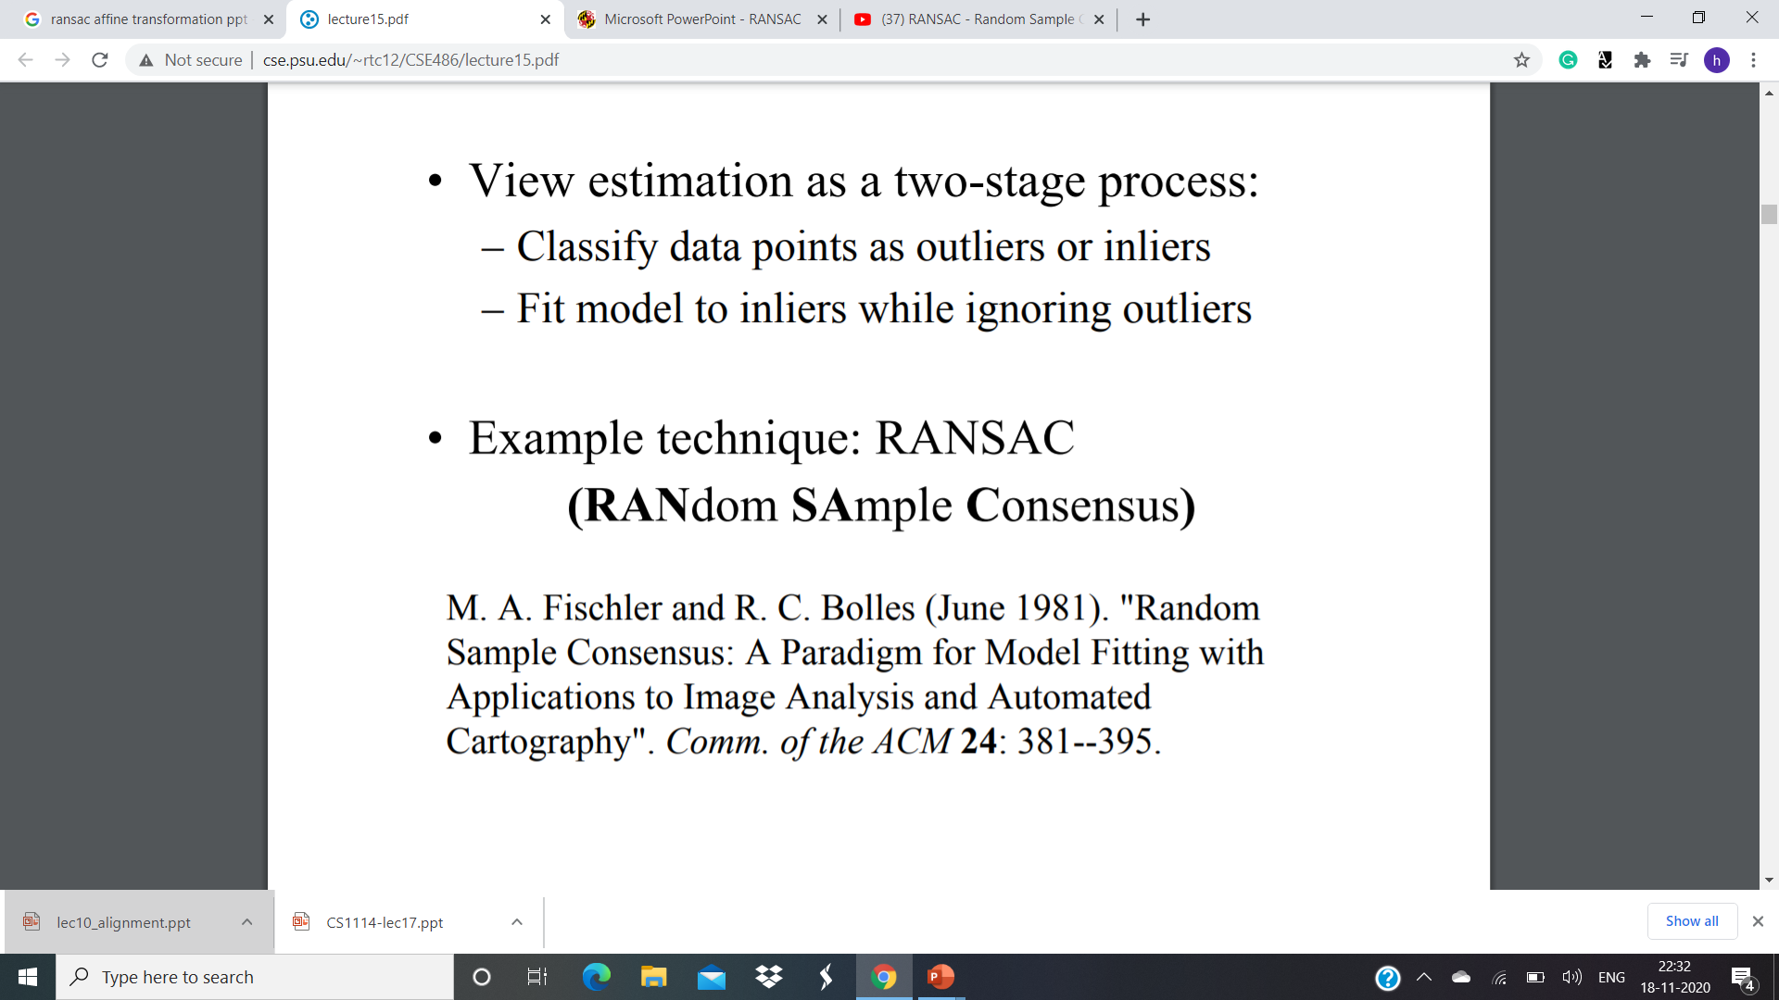
RANSAC

Slide 17
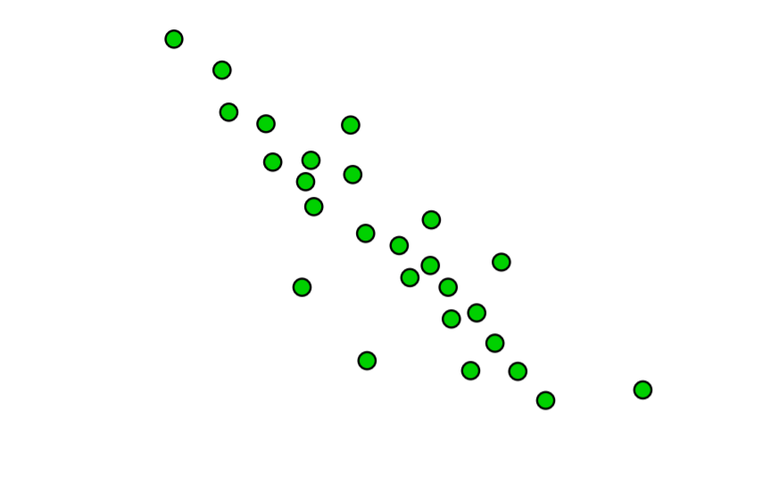
Procedure : Step 1

Slide 18
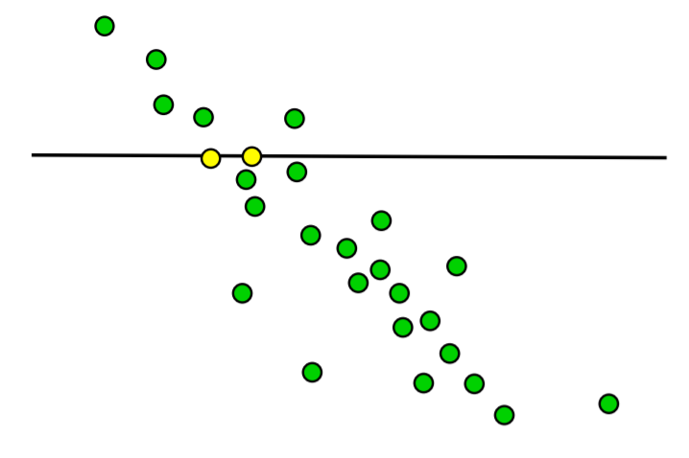
Step 2:

Slide 19
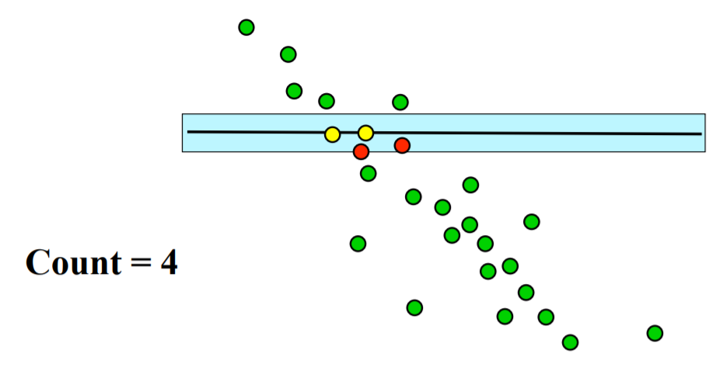
Step 3

Slide 20
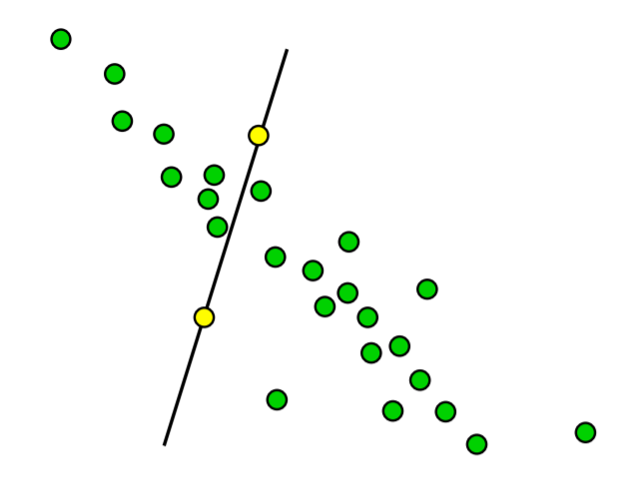
Step 4:

Slide 21
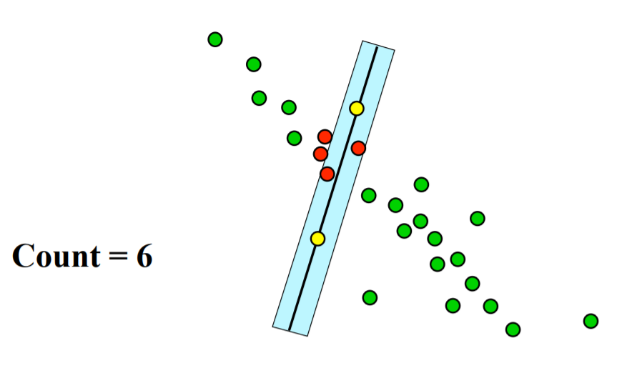
Step 6:

Slide 22
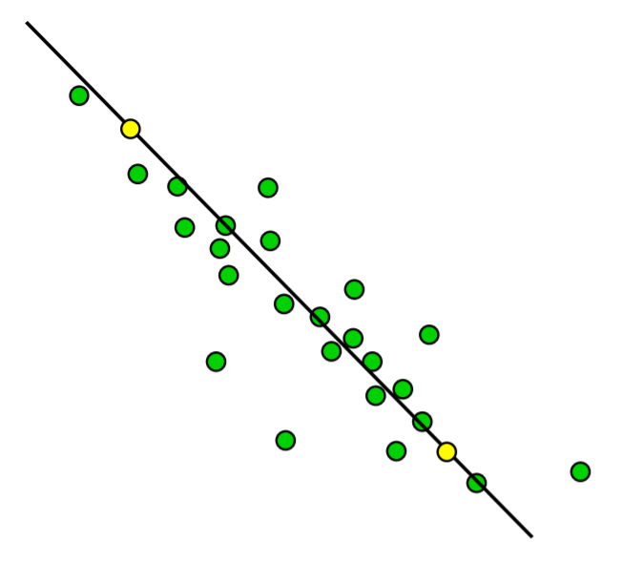
Step 7:

Slide 23
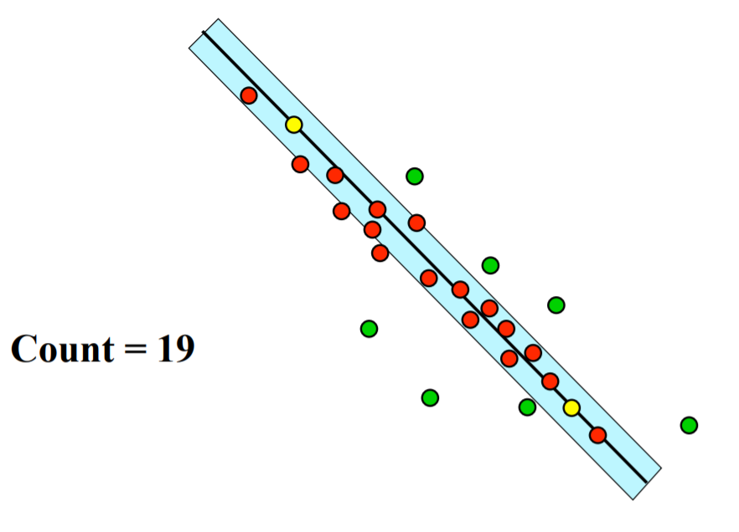
Step 8:

Slide 24
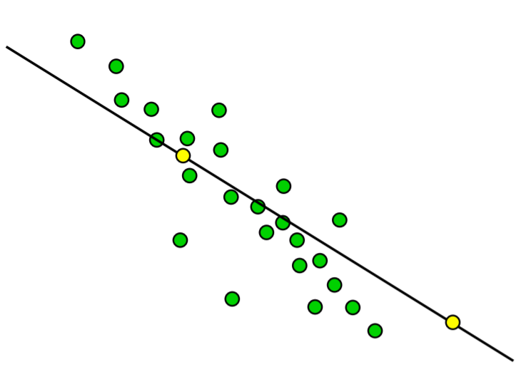
Step 9:

Slide 25
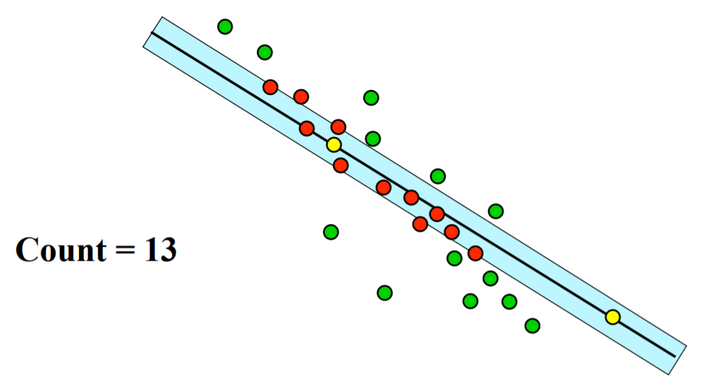
Step 10:

Slide 26
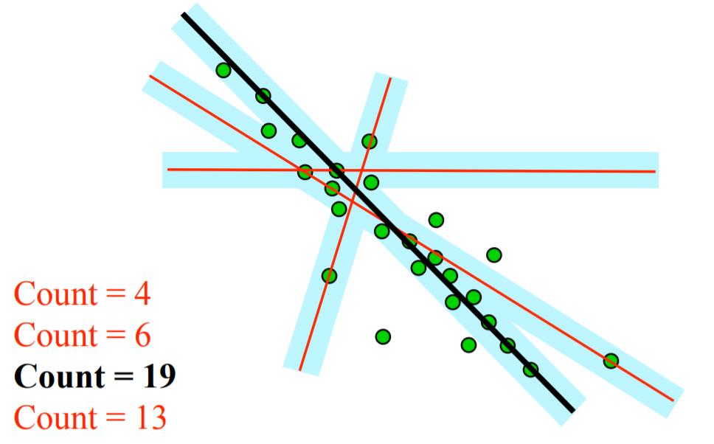
Final step:

Slide 27
How to choose the parameters?
Number if sampled points s
Outlier ratio e (outliers/ datapoints)
How many trials T do we need?
Choose T so that, with probability p, at least one random sample set is free from outliers
1-p =(1- (1-e)^{s})^{T}
P(fail T times) = select at least one outliers in all T trials
Log(1-p) = T log(1-(1-e)^{s}

Slide 28
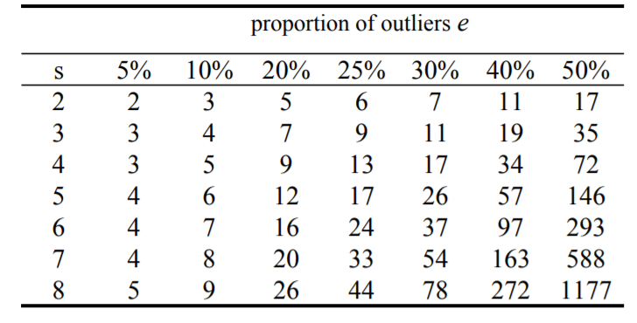
No. of trials T
T = log (1-p) / log(1-(1-e)^{s}

